Slide 1
Variance & Standard Deviation

Slide 2

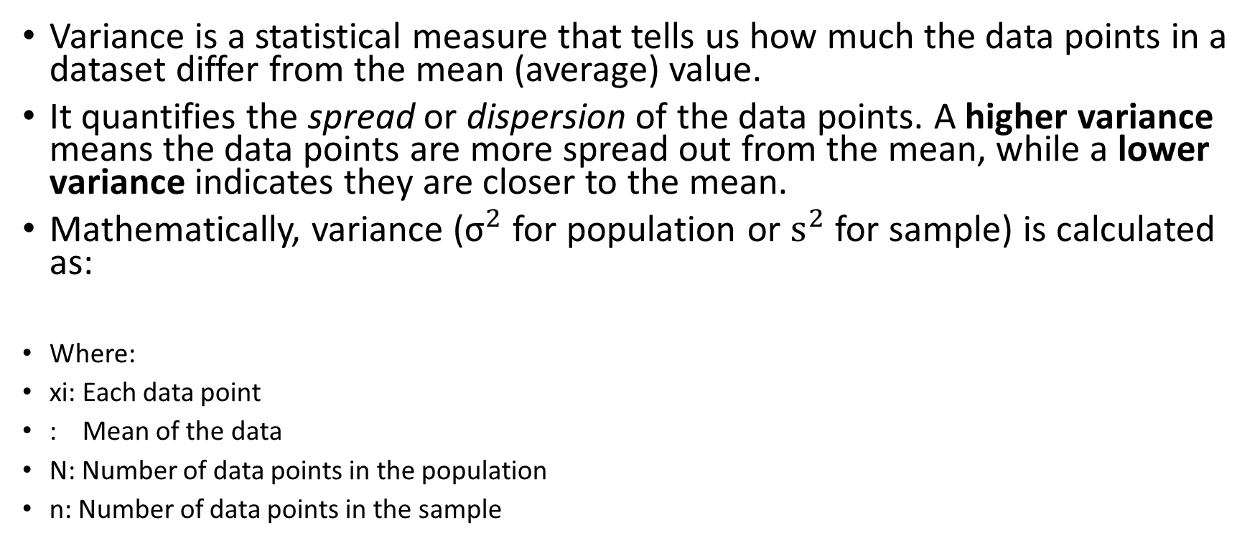
What is Variance in Statistics?
Variance is a statistical measure that tells us how much the data points in a dataset differ from the mean (average) value.
It quantifies the spread or dispersion of the data points. A higher variance means the data points are more spread out from the mean, while a lower variance indicates they are closer to the mean.
Mathematically, variance (${\text{σ}}^{2}$ for population or ${\text{s}}^{2}$ for sample) is calculated as:
Where:
xi​: Each data point
: Mean of the data
N: Number of data points in the population
n: Number of data points in the sample

Slide 3
Analogy: The Spread of a Parade
Imagine a parade where people are marching in a straight line.
If everyone is walking closely together, the "spread" of the group is small—this represents low variance.
If people are scattered along the street, with some walking far ahead and others lagging behind, the "spread" is large—this represents high variance.
The mean in this analogy is the average position of all the people in the parade.

Slide 4
Example 1: Test Scores of Two Classes
Suppose two classes take a math test. Here are the scores:
Class A: 75, 76, 74, 75, 76
Class B: 50, 90, 45, 85, 70

Slide 5

Step 1: Find the Mean

Slide 6


Step 2: Calculate the Squared Differences from the Mean

Slide 7

Step 3: Calculate Variance

Slide 8
Conclusion
Class A has low variance (scores are consistent), while Class B has high variance (scores are more spread out).

Slide 9
Analogy: Shooting at a Target
Imagine two archers shooting arrows at a target:
Low Variance: One archer's arrows are clustered tightly around the bullseye, even if the bullseye is slightly off-center. This shows consistent performance (low spread).
High Variance: The other archer's arrows are scattered all over the target, even though their average position might be near the bullseye.
In this analogy:
The bullseye is the mean.
The spread of arrows represents the variance.

Slide 10
Example 2: Monthly Rainfall in Two Cities
City A: 100 mm, 102 mm, 98 mm, 101 mm, 99 mm, 103mm
City B: 50 mm, 200 mm, 20 mm, 180 mm, 100 mm, 200mm
City A's variance will be small (rainfall is consistent), while City B's variance will be large (rainfall fluctuates greatly).

Slide 11
1. Real Estate Market (House Prices)
Suppose you are analyzing house prices in a neighborhood. You want to understand how consistent the house prices are:
House prices (in thousands of dollars):
220,250,260,280,350

Slide 12

1. Calculate the mean of house prices

Slide 13
2. Calculate the deviations from the mean:

Slide 14
3. Square the deviations

Slide 15

4. Calculate the variance
In this case, the variance of 1796 means that the prices deviate quite a bit from the average price of $272,000. This large variance suggests there may be extreme differences in house values in this neighborhood.

Slide 16
2. Stock Market (Daily Returns)
Imagine you're analyzing the daily returns of a stock to assess its volatility over the past week. The returns represent how much the stock’s value has increased or decreased each day.
Daily returns (percentage):
2%,−1%,3%,−2%, 0%

Slide 17

1. Calculate the mean return:

Slide 18
2. Calculate the deviations from the mean

Slide 19
3. Square the deviations

Slide 20

4. Calculate the variance
The variance of 3.84% indicates the extent to which daily returns fluctuate around the average return of 0.4%. This suggests moderate volatility in the stock's performance over this period.

Slide 21
3. Weather Forecasting (Temperature)
Variance can also be used to analyze temperature data, helping meteorologists understand how consistent the weather is in a given period.
Temperatures (in °C) for a week:
20,22,21,19,23,24,20

Slide 22

1. Calculate the mean temperature

Slide 23
2. Calculate the deviations from the mean:

Slide 24
3. Square the deviations:

Slide 25

4. Calculate the variance:
The variance of 3.14°C indicates the average amount by which the daily temperatures deviate from the mean of 21°C. A relatively low variance suggests that the temperatures are fairly consistent over the week.

Slide 26
4. Performance in a Classroom (Test Scores)
In an educational setting, variance can be used to measure the consistency or variability of student test scores, giving insights into how equally students are performing.
Test scores of 5 students:
85,90,75,60,95

Slide 27

1. Calculate the mean score

Slide 28
2. Calculate the deviations from the mean

Slide 29
3. Square the deviations

Slide 30

4. Calculate the variance
A variance of 154 suggests that there is quite a bit of variability in student performance, with some students doing significantly better or worse than others.

Slide 31
What is Standard Deviation?
Standard deviation (SD) is a measure of how spread out or dispersed the data is from its mean. It gives us an idea of how much individual data points typically deviate from the average value of the dataset.
Mathematically, the standard deviation is the square root of the variance. If variance measures the "average squared deviation" from the mean, standard deviation brings it back to the original units of the data, making it easier to interpret.

Slide 32
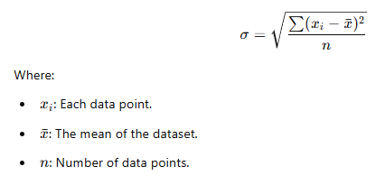
Formula for Standard Deviation
The formula for a dataset with n values is:

Slide 33
Analogy: Measuring Spread of Heights
Imagine a group of 10 students in a classroom. You want to measure how tall they are on average and how much their heights vary.
The Mean: The average height gives you the "center" or "expected" height.
Standard Deviation: The standard deviation tells you how far, on average, individual students' heights deviate from this mean.
A low standard deviation means most students are close to the average height.
A high standard deviation means heights are widely spread—some students are very short, and some are very tall.

Slide 34
Example with Data
Let’s calculate the standard deviation for a small dataset:
Heights of 5 students (in cm):
160,165,170,175,180

Slide 35

Step 1: Calculate the Mean:

Slide 36
Step 2: Find the Deviations from the Mean

Slide 37
Step 3: Square Each Deviation

Slide 38

Step 4: Calculate the Variance

Slide 39

Step 5: Take the Square Root of the Variance
The standard deviation of this dataset is approximately 7.07 cm.

Slide 40
Real-World Application of Standard Deviation
Weather Forecasting:
If a city's average temperature in November is 15°C with a standard deviation of 2°C, most days will have temperatures close to 15°C (e.g., between 13°C and 17°C).
A higher standard deviation (e.g., 10°C) would mean temperatures could vary widely (e.g., 5°C to 25°C).
School Test Scores:
In a math test where the mean score is 80:
A low SD (e.g., 5) means most students scored between 75 and 85, showing consistency.
A high SD (e.g., 20) means scores vary widely (e.g., from 60 to 100), indicating a mix of strong and weak students.

Slide 41
Summary
Standard deviation is a measure of data spread around the mean, expressed in the same units as the data.
It helps us understand how much variation exists in a dataset.
Low SD: Data points are close to the mean.
High SD: Data points are widely spread out.

Slide 42
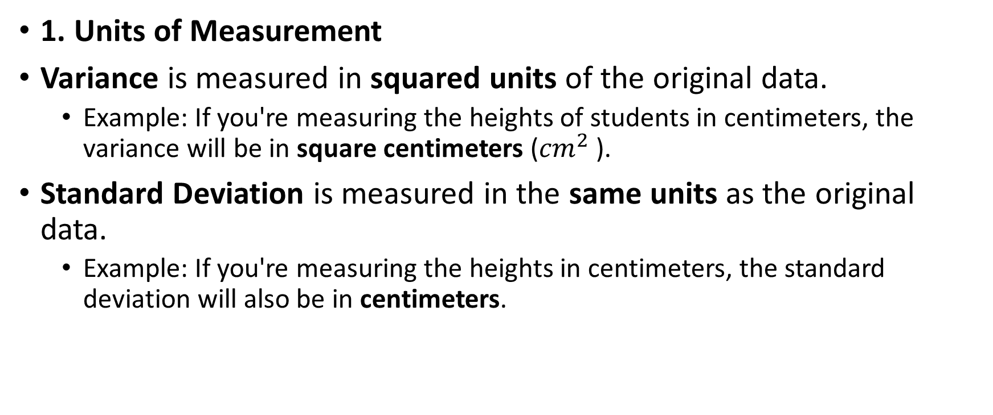
Key Differences between Variance and Standard Deviation:
1. Units of Measurement
Variance is measured in squared units of the original data.
Example: If you're measuring the heights of students in centimeters, the variance will be in square centimeters (${cm}^{2}$ ).
Standard Deviation is measured in the same units as the original data.
Example: If you're measuring the heights in centimeters, the standard deviation will also be in centimeters.

Slide 43
Why does this matter?
When you compute variance, the squared units make it harder to directly compare or interpret the result.
Standard deviation, on the other hand, brings the measure back to the original units, making it more intuitive and easier to understand in real-world terms.

Slide 44
2. Interpretability
Variance is a bit abstract because it involves squared units, making it harder to directly relate it to the spread of the data. For example, in the case of heights, a variance of 50 cm² is harder to interpret.
Standard Deviation is easier to interpret because it directly tells you, on average, how much individual data points deviate from the mean, in the same units as the data itself (e.g., centimeters, dollars, etc.).

Slide 45
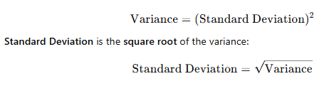
3. Mathematical Relationship
Variance is the square of the standard deviation.
This means that standard deviation is always the square root of the variance, and it reverses the effect of squaring the deviations when calculating variance.

Slide 46
Example to Illustrate the Difference
Let’s say we have a dataset of student exam scores:
Scores:60,70,80,90,100

Slide 47

Step 1: Find the Mean:

Slide 48

Step 2: Calculate the Variance
Deviations from the mean: −20,−10,0,10,20
Squared deviations: 400,100,0,100,400
Variance:

Slide 49

Step 3: Calculate the Standard Deviation
Standard Deviation:
Standard Deviation = 200 ≈ 14.14
Summary of the Measures:
Variance: 200 (measured in squared units)
Standard Deviation: 14.14 (measured in the same units as the data)

Slide 50
Summary
Variance gives you the "average squared" deviation from the mean, but is in squared units, which can be less intuitive.
Standard Deviation is simply the square root of the variance, making it more interpretable and in the same units as the data itself.

